Slide 1







Human Face Recognition Using Computer vision (Deep Learning)
Track Name : Manufacturing
Team Name : SPartans
Team Leader : Gayatri ChawAda
Team Members: Abhishek Gaikwad, Arth I Jani, Harshil Savaj, Nakul Gupta

Slide 2
Problem Statement
In this project, our goal is to identify the human face real time from a CCTV (For this project we will provide you Video Clip) camera with the help of computer Vision.
If CCTV camera frame (image from the Video) contains multiple faces, then developed model must have capability to recognize all the faces in frame.
After recognition of faces developed, Software will return the face identity (For Example Employee Code) and Date and time of recognition in a csv file (You can also insert the record into MySQL database).

Slide 3
Introduction
This model is going to recognize the human face from live video with the help of computer vision and going to keep the track of that detection for future use. We can integrate this model with CCTV camera.
Use of this type of CCTV cameras for surveillance is gradually increased in last few years. This CCTVs are becoming very useful for industries for security purpose and to keep the record of their employees during working hours.

Slide 4
Approach
We are going to use OpenCV’s pre-trained model (haarcascade_frontalface_default.xml) to recognize the human’s face
We collected a dataset of 3000 images of 30 employees. It will include a sufficient number of images of each person taken from different angles and in different lighting conditions.

Slide 5
Why should one choose our solution?
There are several facial recognition models available in the market, each with their own unique features and capabilities.
Our model is highly customizable to suit the specific needs of our clients. We can customize the model to detect specific individuals or groups of individuals, as well as to track their movements and activities within a designated area.

Slide 6
Limitations of Our Solutions
The accuracy of the model can be affected by various factors, such as poor lighting, occlusions, and changes in facial appearance (e.g., wearing glasses, growing a beard).
The model may struggle to identify individuals who are not already in its database.
The model may produce false positives or false negatives. A false positive occurs when the model identifies someone as a particular individual, but they are not actually that person. A false negative occurs when the model fails to identify someone who is actually the target individual.
The use of facial recognition technology for surveillance purposes raises concerns about privacy.

Slide 7
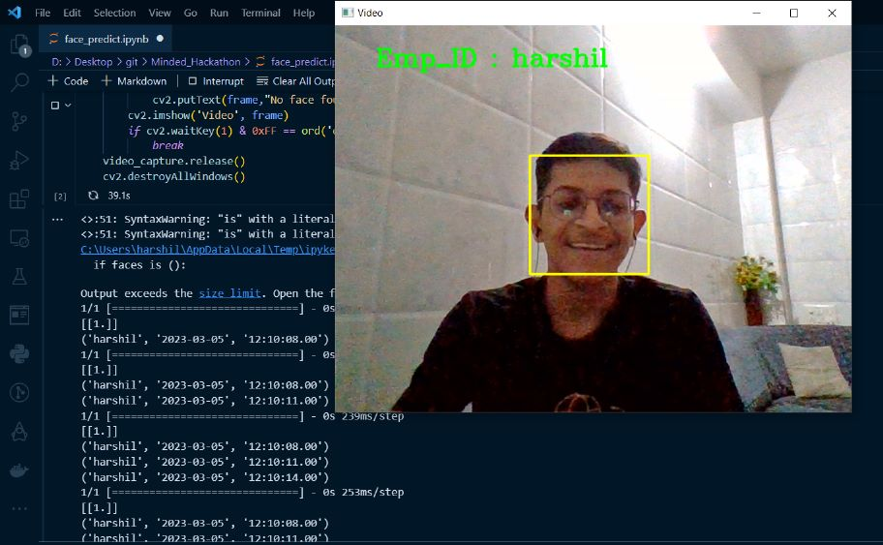

Demo
Inserting Information of Recognized face into Database..
Running Model to recognize Face.

Slide 8
References
A pre-trained model of OpenCV (haarcascade_frontfalface_default.xml).

